Slide 1
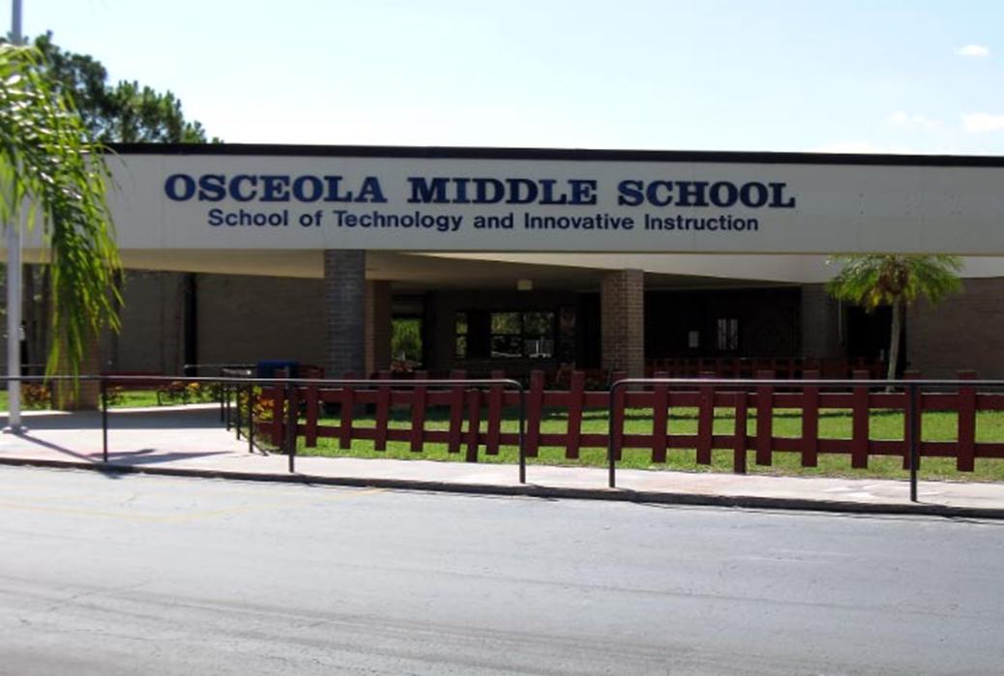


Welcome Back Chiefs!
VISION: 100% Student Success
MISSION: Osceola Middle School serves the diverse needs of our students by providing learning opportunities to promote highest student achievement in a safe, structured environment.

Slide 2

The OMS Administrative, Counselor, and Clerical Support Teams 2023-2024:
8th Grade Office
Building 4 2nd floor
Dr. Adams, Assistant Principal
Ms. Krupp, 8th grade Counselor
Ms. Lehner, Clerk
7th Grade Office
Building 5, 2nd floor
Mr. Smith, Assistant Principal
Ms. Knapp, 7th grade Counselor
Ms. Nasseh, Clerk
6th Grade Office
Building 5, 1st floor
Ms. Scott, Assistant Principal
Ms. McLellan, 6th grade Counselor
Ms. Carroll, Clerk
Building One Front Office
Derrik Craun, Principal Michelle Shepard, Principal's Secretary

Slide 3
OSCEOLA MIDDLE SCHOOL
2023-24 BELL SCHEDULE
A Lunch 6th Grade | B Lunch 7th Grade | C Lunch 8th Grade
Enrichment Period 9:40-10:10 | Enrichment Period 9:40-10:10 | Enrichment Period 9:40-10:10
1st Period 10:14-11:05 | 1st Period 10:14-11:05 | 1st Period 10:14-11:05
Lunch 11:05-11:35 | 2nd Period 11:09-12:00 | 2nd Period 11:09-12:00
2nd Period 11:39-12:30 | Lunch 12:00-12:30 | 3rd Period 12:04-12:55
3rd Period 12:34-1:25 | 3rd Period 12:34-1:25 | Lunch 12:55-1:25
4th Period 1:29-2:20 | 4th Period 1:29-2:20 | 4th Period 1:29-2:20
5th Period 2:24-3:15 | 5th Period 2:24-3:15 | 5th Period 2:24-3:15
6th Period 3:19-4:10 | 6th Period 3:19-4:10 | 6th Period 3:19-4:10

Slide 4
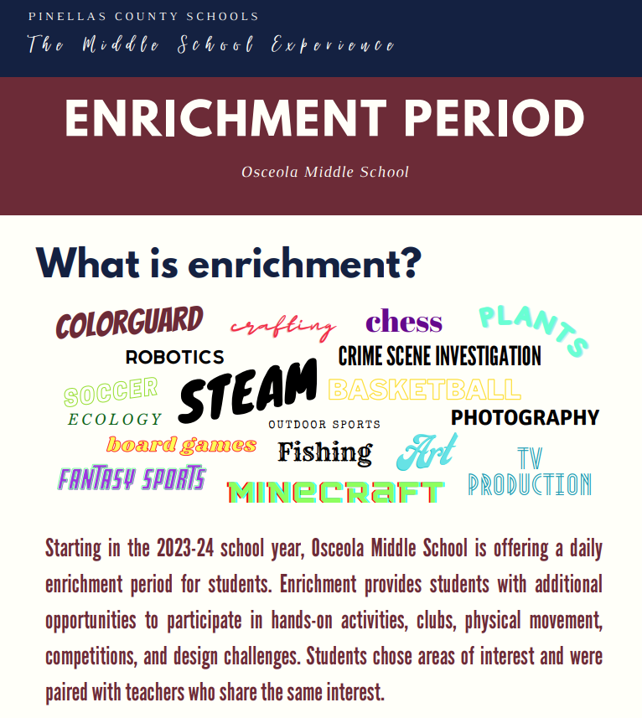
OMS Enrichment

Slide 5

6th Grade Course Options and Beyond
Subject Areas: | 6th Grade Course Options: | 7th and 8th Grade Options:
Language Arts (1 period) | LA 1 Advanced | (7th Gr.) - LA 2 Advanced (7th Grade) (8th Gr.) - LA 3 Advanced or English 1 Honors HS
Mathematics (1 period) | Grade 6 Math or Accelerated Math Grade 6 or Accelerated Math Grade 7 (*Must complete 6th Grade Math Prior to new school year) | (7th Gr.) - Grade 7 Math or Accelerated Math or Algebra 1 Honors HS (8th Gr.) Pre-Algebra or Algebra 1 honors or Geometry Honors HS
Science (1 period) | Science 1 Advanced or Science 1 Accelerated Honors | (7th Gr.) - Science 2 Advanced or Science 2 Accelerated Honors (8th Gr.) Science 3 Advanced or Physical Science Honors HS
Social Studies (1 period) | World History or US History Advanced | (7th Gr.) - US History or Civics Advanced (8th Gr.) Civics or Pre-AP World History HS
Physical Education (1 period) | Fitness Grade 6/Computer Applications * PE waivers can be completed online | (7th Gr.) - Team Sports/Grade 7 Health-required (can take online in summer after 6th grade year) (8th Gr.) PE Sports/Wellness
Electives (1 period) | AVID 6, Band 1, Chorus 1, ESE Social Skills, Gifted, Orchestra 1, Wheel 1 (Coding, STEM, and Art) or Wheel 2 (Coding, STEM, and Spanish) Reading is required for all students who score level 1 on the previous year PM3 FAST Reading assessment | (7th Gr.) – 2D/3D Art, AVID 7, Band 2, Chorus 2, Coding Fundamentals, Gifted, Orchestra 2, Spanish 1 HS, STEM (8th Gr.) Pre-AP Visual Art HS, AVID 8, Chorus 3, Digital Info Tech HS, Gifted, Office Assistant, Spanish 1 or Spanish 2 HS, STEM,

Slide 6
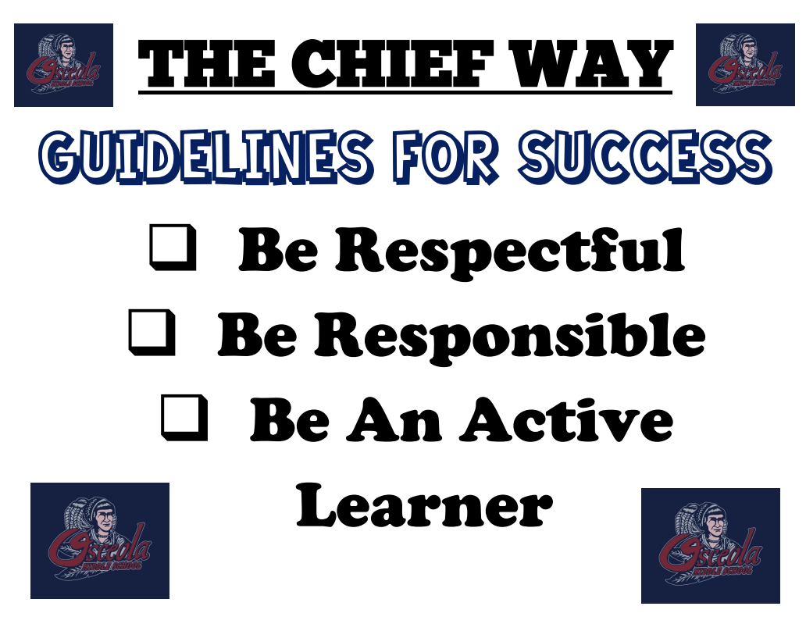
OMS Guidelines for Success

Slide 7

Parent/Student/Staff Agreement
OMS Parent / Guardian Agreement: I want my child to reach his / her full academic potential; therefore, I will do the following to support my child’s learning:
Maintain on-going communication and updated contact information with my student’s school
Attend school events when available
Ensure my child comes to school on time each day ready to learn with a fully charged laptop
Review my student’s academic progress with my student at least weekly using FOCUS
Encourage educational reading and completion of homework
Review the school wide binder contents with my student on a weekly basis
OMS Student Agreement: It is important that I do the best that I can; therefore, I will do the following:
Come to school on time with a fully charged laptop, cell phone kept away, in compliance with dress code and ready to learn each day
Believe in my ability to learn and engage in the educational process
Work to the best of my ability
Respect others at all times
Maintain an organized school binder system for all of my classes and review with my parent weekly

Slide 8

Osceola Middle School Dress code
Your Shirts: Solid in any color and cover up to the neck, only a small logo (no bigger than 2 inches) is acceptable. The only printed shirts allowed are Osceola Middle School T-shirts.
Bottoms: Must be khaki, navy blue, or black only, neat in appearance (un-torn), and worn at the waist. Shorts must be knee length. Athletic, nylon or knit type shorts/pants, and are not permitted, with the exception of gym class. Blue jeans are allowed as long as they are neat in appearance and they are plain solid blue, full length, free of any wording, embroidery, design, as well as un-torn/un-ripped/no holes/frays. Not permitted bottoms include spandex, jeggings/leggings, sweatpants, athletic pants, joggers, or Pajamas.
Footwear: Shoes must have a heel strap or closed back. Not permitted footwear include flip flops, slides, slippers or crocs.
Outerwear: Plain sweatshirts, sweaters, and jackets must be solid in color. Hoods, hats or other head coverings are not permitted to be worn once a student is on campus. All backpacks, fanny packs, belt bags, and purses exceeding 8 by 10 inches must be stored in lockers during the school day and are not to be worn nor carried throughout the day.

Slide 9
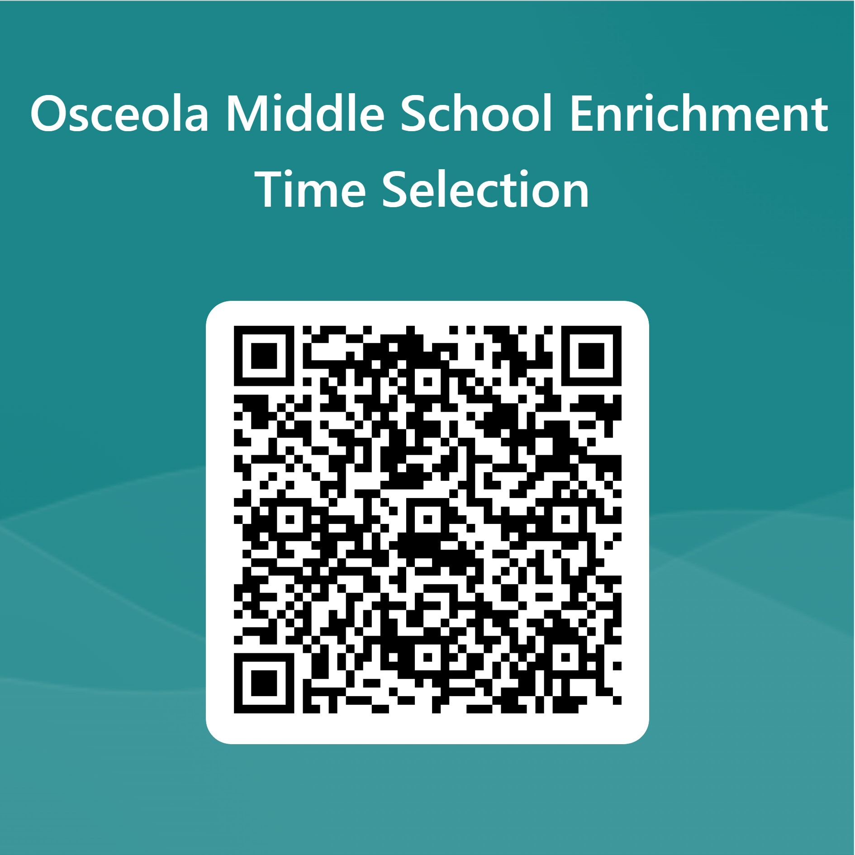
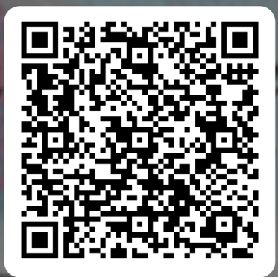
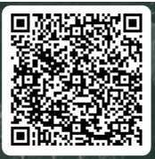
STEAM Academy, Enrichment Selection and AVID Application
STEAM Academy QR:
AVID Application QR:
PE Waiver if requested:
https://asd.pcsb.org/SchoolWiresForms/PE_Waiver/

Slide 10

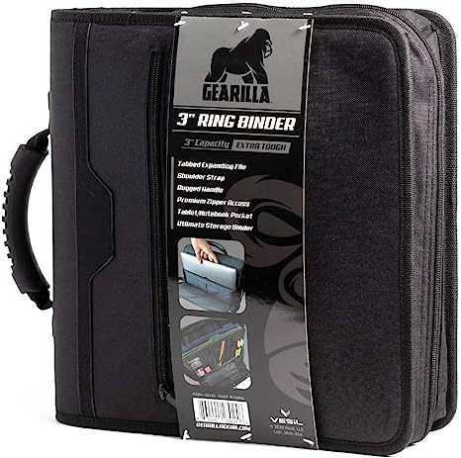
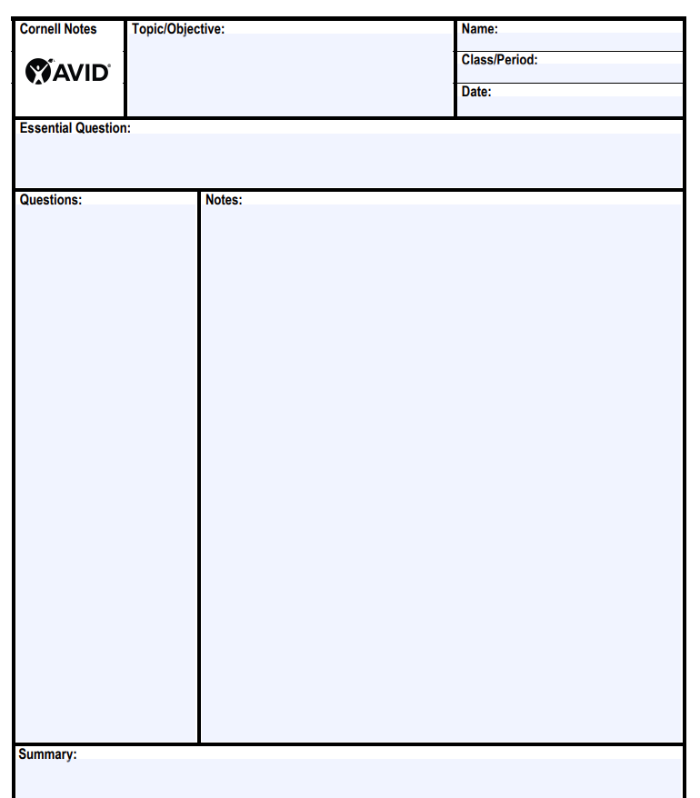
How do we promote highest student achievement ?
Staying Organized
Utilizing Focused Note-Taking to deepen understanding

Slide 11
Recommended Supplies
It is our expectation that all OMS students bring their fully charged laptops and a 3' binder to and from school every day. This will help keep all students organized and allow students to have access to materials. In order to protect student laptops and make it easy for students to carry laptops and binders to every class, we suggest all families purchase a 3 inch binder with a laptop case all-in-one.
The only other recommended supplies for you to purchase are packs of loose leaf paper, 6 dividers for the binder, at least 3 spiral notebooks, and writing utensils of your choice. There may be a few additional recommended classroom supplies communicated by individual teachers on the opening days of school. However, we are trying to keep them limited to offset the cost of purchasing a binder/laptop case.

Slide 12
OMS Campus Overview
Our campus has 5 buildings:
Building 1 is the main office and music and technology classrooms
Building 2 is the cafeteria/multipurpose room
Building 3 is the gym
Buildings 4 has two floors (1st floor is art and ese classrooms, 2nd floor is mostly 8th grade classrooms)
Building 5 also has 2 floors (1st floor is 6th grade and 2nd floor is 7th grade classrooms)

Slide 13
https://www.pcsb.org/osceola-ms has lots of valuable information for you! Let’s look together…
Weekly Call out updates
Parent meeting schedules
Bell schedule
Modified Dress Code
New student orientation powerpoint – please review with your son or daughter again if needed
Information for all clubs, organizations, and sports

Slide 14
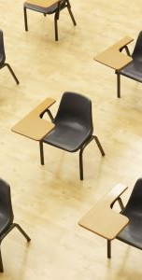
School Attendance
Attend Today, Achieve Tomorrow!
Excuse notes
  48 hours for written excuse notes
PTLs
  Parents/Guardians must call in PTLs to the office.
  Students' academic performance may be negatively impacted by early sign out. Signing out early repeatedly may count toward a pattern of non-attendance that may indicate early signs of truancy.
Notes:
Excuse notes should be submitted to program offices.
PTL’s – students showing us a text from parents are not permissible, please refrain from requesting PTLs during the last 30 minutes of the school day.

Slide 15
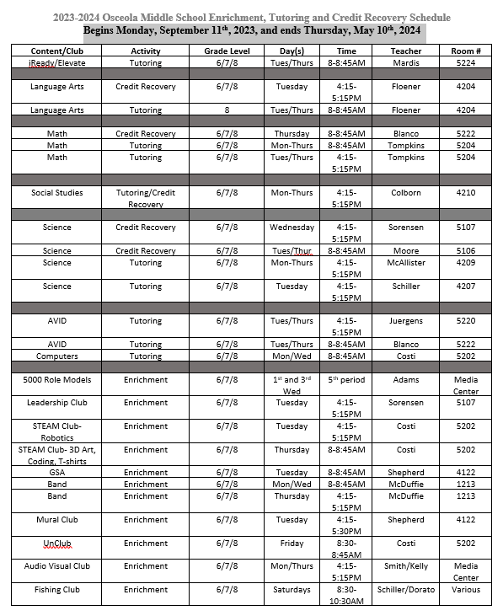
Before and After School Clubs and Extended Learning

Slide 16
Important upcoming Dates:
July 27th – Peer Connect for incoming 6th Graders (9-11am or 5-7pm)
August 8th – Chief Community Day (9am – 12pm)
August 10th – 1st Day of School (Gates open at 9:20am, free breakfast and lunch)
August 24th – Back to School Night 5:30-7:30pm
August 29th – School Picture Day
August 30th – SAC and PTSA meetings begin @ 5:30pm in Media Center

